Slide 1
Expert Review in
Next Generation Sequencing:
Integration of Next Generation Sequencing Into Clinical Management of Solid Tumors
Reference Slide Deck
Moderator
Robert E. Coleman, MD, FRCP, FRCPE
Medical Director, prIME Oncology
Discussants
Fabrice André, MD, PhD
Institute Gustave Roussy, Villejuif, France
Dirk Arnold, MD, PhD
Tumor Biology Center Freiburg, Freiburg, Germany
Mary O’Brien, MD, FRCP
Royal Marsden Hospital, London, United Kingdom

Slide 2

Introduction and Overview

Slide 3
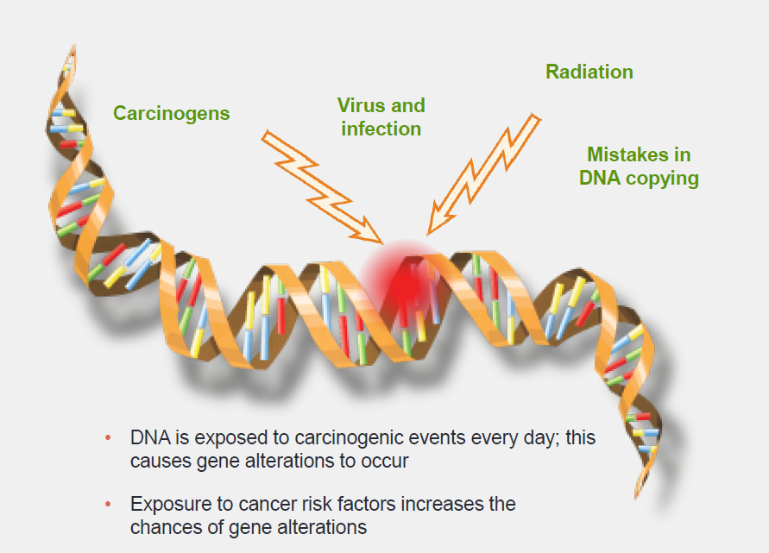
Cancer Is a Disease of the Genome
DNA is exposed to carcinogenic events every day; this causes gene alterations to occur
Exposure to cancer risk factors increases the chances of gene alterations

Slide 4
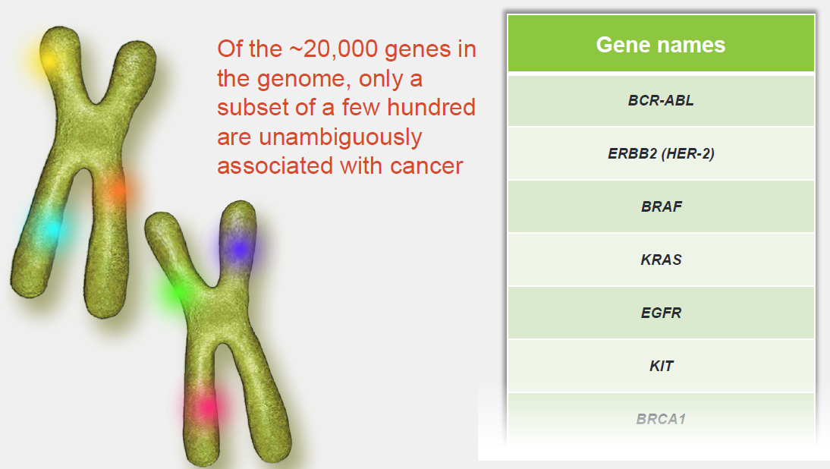
Cancer-Related Genes

Slide 5
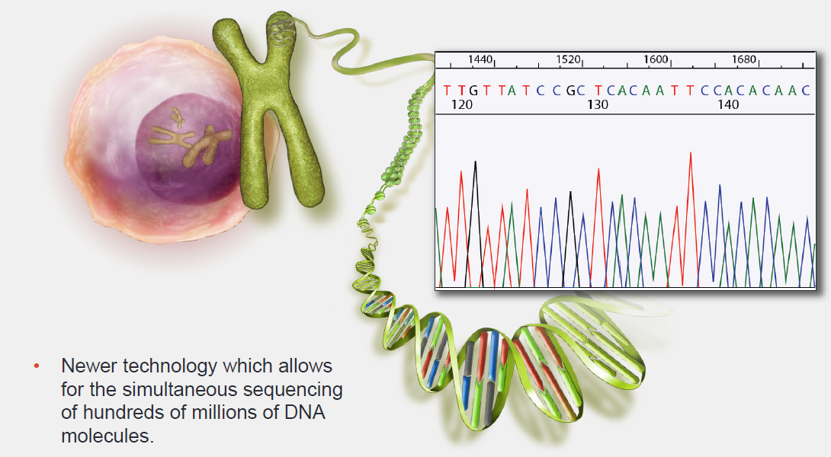
What is Next Generation Sequencing (NGS)?

Slide 6
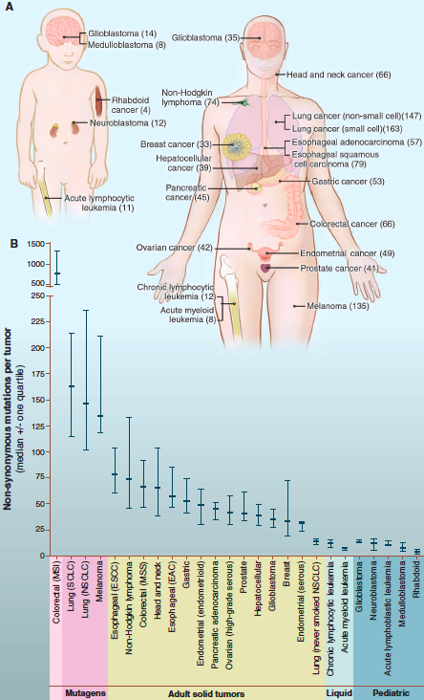
Frequency of Mutations Across Cancer
Melanomas and lung tumors display many more mutations than average, with ~200 nonsynonymous mutations per tumor.
These larger numbers reflect the involvement of potent mutagens. Accordingly, lung cancers from smokers have 10 times as many somatic mutations as those from nonsmokers.
Vogelstein B, et al. Science. 2013;339(6127):1546-1558.

Slide 7
Targeted approaches allow rapid screening of multiple genes for clinically relevant mutations

Slide 8
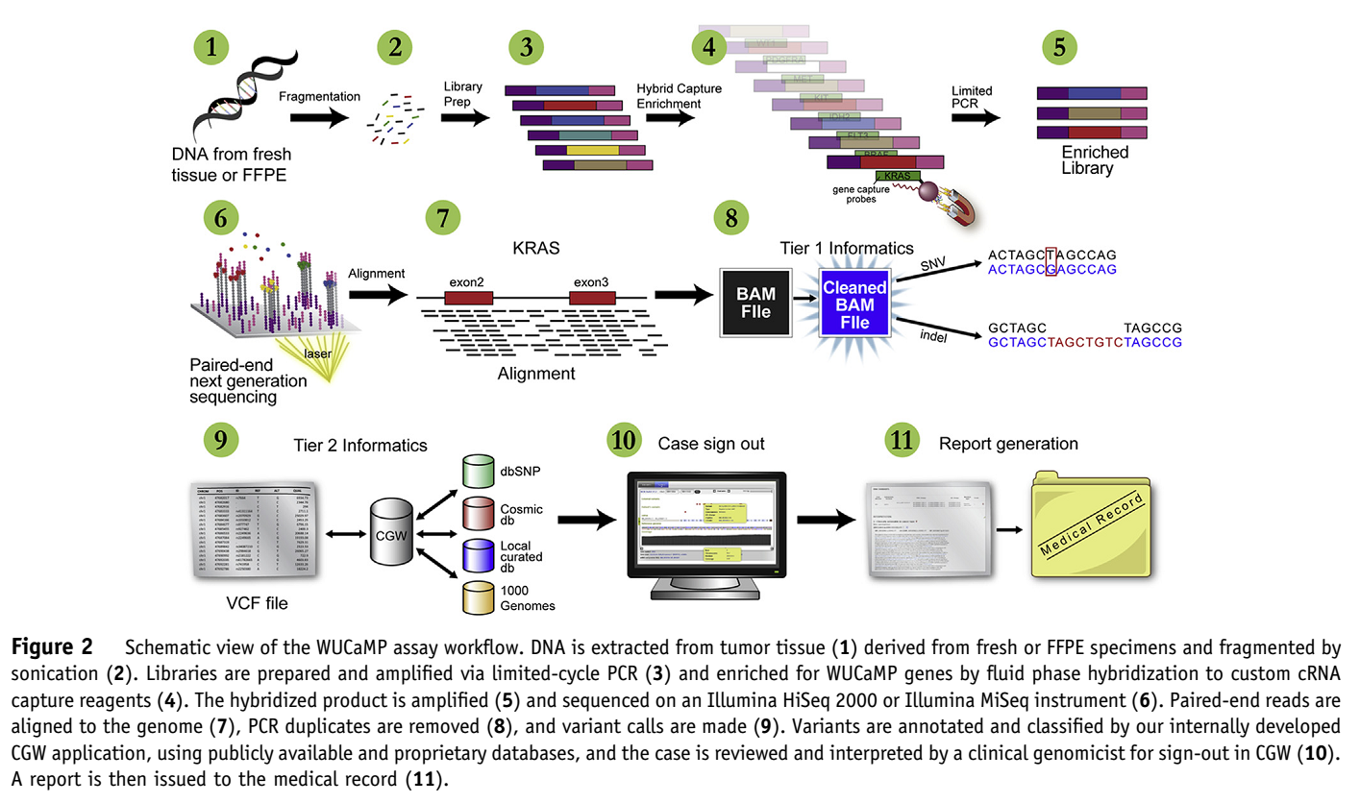
The Clinical Diagnostic Workflow
Cottrell CE, et al. J Mol Diagn. 2014;16(1):89-105.

Slide 9
NGS Modalities
Whole-genome sequencing
Determines the complete DNA sequence of an organism’s genome at a single time
Whole-exome sequencing
Selectively sequences only the coding areas of the genome
Targeted sequencing (hot spot)
Sequences only the hot spots of a subset of genes of interest
Fully informative sequencing
Sequences a defined subset of genes of interest in their entirety

Slide 10
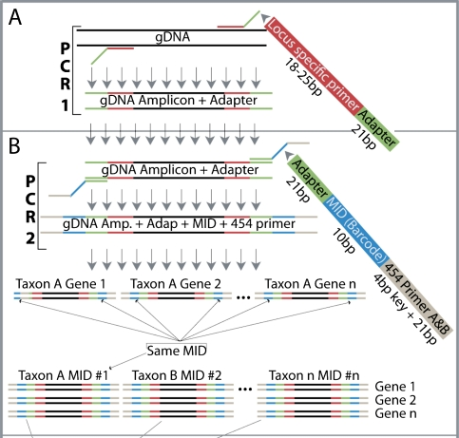
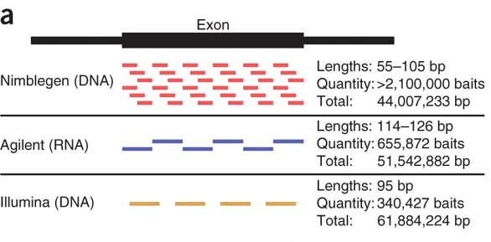
Targeted Sequencing Approaches
Amplicon Sequencing
(Whole) Exome Sequencing
Clark MJ, et al. Nat Biotechnol. 2011;29(10):908-914.
Bybee SM, et al. Genome Biol Evol. 2011;3:1312-1323.

Slide 11
Mutation Detection in Next-Generation Sequencing
High throughput
Survey many cancer-related genes at once
Mostly unbiased detection of all mutation types
Single-nucleotide variations
Copy-number alterations
Indels, inversions, translocations
Readout of the mutation frequency
Quantification of mutations in heterogeneous samples

Slide 12
NGS Data Quality and Quantity
Sample
NGS
Bioinformatics
Origin
Preparation
Storage
Platform
Application
Provider
Semi-customized
Fully-customized
Provider
Custom software packages
Customized workflow (more advanced tools)

Slide 13
Development of the Most Suitable Bioinformatics Workflow
Fundamental element of an NGS pipeline is the mapping tool
Determine the optimal mapper for your application (not trivial!) (choose from more than 80 mapping tools)
Compare most important features/characteristics of mapping tools
Select the mapping tools most probably addressing your needs
Evaluate the reduced subset of mappers in terms of their accuracy
Additionally fundamental to a cancer NGS pipeline is the variant caller

Slide 14
Sequencing vs Bioinformatic Costs
Sample collection and experimental design
Sequencing
Data reduction
Downstream analyses
Data management
100%
The higher the number of sequencing errors,
the higher the number of variations to be annotated,
the higher the bioinformatic costs.
0%
Pre-NGS
(Approximately 2000)
Now
(Approximately 2010)
Future
(Approximately 2020)
Sboner A, et al. Genome Biol. 2011;12(8):125.

Slide 15
Factors to Consider When Interpreting Results
Tumor purity
Coding or non-coding mutation ?
Rare germline single nucleotide polymorphism (SNP)?
Known oncogene or tumor suppressor?
Has variant been reported before?
Is it clonally dominant?
How many driver events?
Is there functional evidence for mutation activity in the literature?
Hotspot mutation in an oncogene
Deleterious mutation in a tumor suppressor

Slide 16
Interpreting Results (cont)
Does tumor type in question have a tendency for hypermutation?
Melanoma, NSCLC, MSI+ colorectal cancer
Does mutation have the hallmarks of an FFPE artifact (v low frequency C>T or G>A mutations)?
Read the small print - what exons are covered?
Determine which codons were not effectively sequenced in the sequencing reaction:
Absence of a driver mutation does not necessarily mean the driver is not present
Variant allele frequencies close to 50% or 100% - suspect a germline event
Vigilant for cancer-predisposing germline mutations

Slide 17
Possible Applications of NGS to Better Understand Tumor Biology

Slide 18

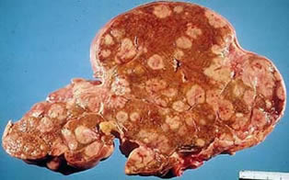

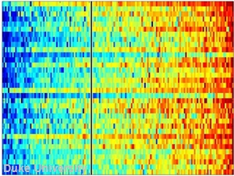



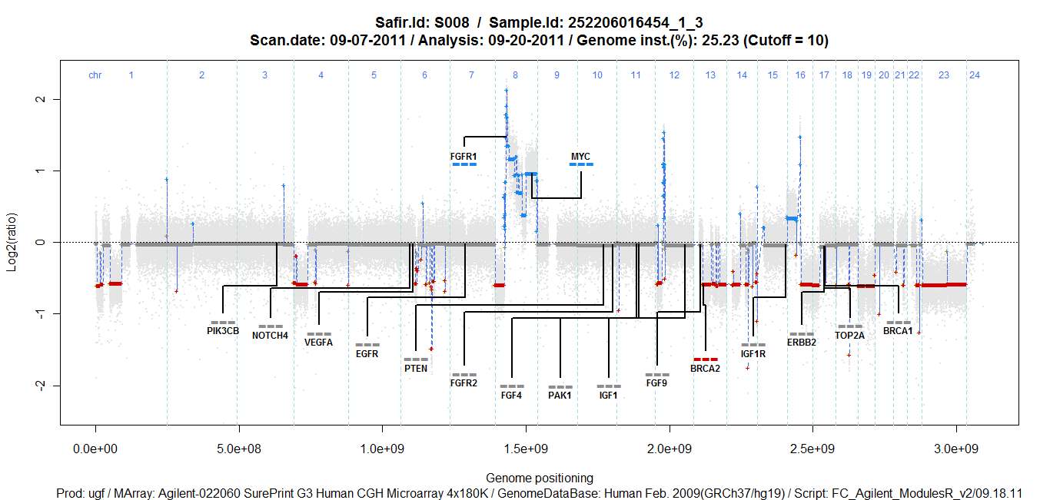
Future Application Of Genomics:
Understand the Biology at the Individual Scale
Patients with lethal cancer
Tumor specimen
Molecular profiling
Targeted therapy according to the molecular profile
The deliverable: A tool to decipher the molecular mechanisms involved in cancer progression in each patient

Slide 19
How Can Genomics Help the Oncologist Understand the Biology in Each Patient in Order to Provide Better Treatment?
Identify the driver:
Targeted sequencing + capacity to quantify CNA
ctDNA to scale-up
Track & kill the lethal clone
Intratumor heterogeneity and resistance to therapy
Ultradeep sequencing and ctDNA to find the lethal clone
Long-term perspectives:
Define the mutational process: whole-exome sequencing
Understand the dialogue between cancer cell & immune system: whole-exome sequencing

Slide 20
Genomic Tests to Identify Oncogenic Drivers at the Individual Scale
Targeting oncogenic
drivers:
oncogene de-addiction = tumor shrinkage
Oncogenic drivers:
Malignant transformation
Cancer progression
Normal cell
Cancer progression
Residual disease
Can we identify oncogenic drivers in individuals,
in order to shrink the tumor?

Slide 21
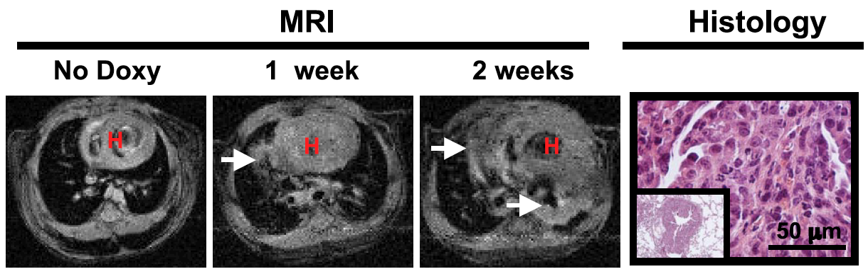
Inducible expression of mutated HER2 (HER2YVMA): Rapid development/maintenance of adenosquamous lung tumors in mice
A Preclinical Example of an Oncogenic Driver
Doxy, doxycycline
Perera SA, et al. Proc Natl Acad Sci U S A. 2009;106(2):474-479.
Notes:
we demonstrate that inducible expression of the most common HER2 mutant (HER2YVMA) in mouse lung epithelium causes invasive adenosquamous carcinomas restricted to proximal and distal bronchioles. Continuous expression of HER2YVMA is essential for tumor maintenance, suggesting a key role for HER2 in lung adenosquamous tumorigenesis. Preclinical studies assessing the in vivo effect of erlotinib, trastuzumab, BIBW2992, and/or rapamycin on HER2YVMA transgenic mice or H1781 xenografts with documented tumor burden revealed that the combination of
BIBW2992 and rapamycin is the most effective treatment paradigm causing significant tumor shrinkage.

Slide 22
Beyond the Drivers:
How the Use of Genomic Tests Could Help Avoid Resistance?
Oncogenic drivers
Oncogene de-addiction
Normal cell
Cancer progression
Residual disease
Resistant disease

Slide 23
How Could the Use of Genomic Tests Help Avoid Resistance?
Does intratumor heterogeneity predict resistance to therapy?
Is it possible to detect the lethal subclone in primary tumor using deep sequencing…and kill it?
Is it possible to detect the appearance of lethal subclone by using circulating DNA… and kill it?

Slide 24
Which Gene Is a Good Candidate to Work on This Concept in BC ?
0.3%
2%
14%
0%
0.4%
14%
Mutated in metastases
Not in primary (using low coverage)
Mediates resistance to therapy
0.6%
0.4%
32%
14%
11%
23%
43%
35%
36%
19%
37%
50%
Toy W, et al. Nat Genet. 2013;45(12):1439-1445.

Slide 25
Does Intratumor Heterogeneity Predict Resistance to Therapy?
100 –
75 –
50 –
25 –
P = .006
Subclonal driver absent (n = 28)
% Alive Without Retreatment
CLL Treated
With Fludarabine
High ITH
Subclonal driver present (n = 39)
0 20 40 60 80
Months From First Therapy
Intratumor heterogeneity could define a disease resistant to therapy
Landau DA, et al. Cell. 2013;152(4):714-726.

Slide 26
Is It Possible to Detect the Lethal Subclone in Primary Tumor ?
Lethal subclone at diagnosis:
A minority clone present
at early stage, resistant to therapy
and leading to cancer death
Oncogenic drivers
Oncogene de-addiction
Normal cell
Cancer progression
Residual disease
Resistant disease

Slide 27
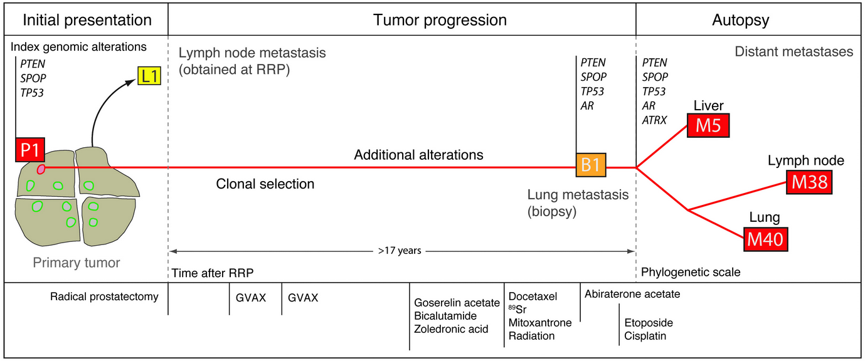
Ultradeep sequencing (x40,000) could detect the lethal minority subclone in primary tumor
Is It Possible to Detect the Lethal Subclone in Primary Tumor?
Lethal clone present in a
minority of cells in the
primary tumors
Hafner MC, et al. J Clin Invest. 2013;123(11):4918-4922.

Slide 28
Is It Possible to Detect the Appearance of Lethal Subclone ?
Acquired lethal subclone:
A minority clone not detectable
at early stage by deep sequencing,
resistant to therapy
and leading to cancer death
Targeting oncogenic
drivers:
oncogene de-addiction
Oncogenic drivers
Normal cell
Cancer progression
Residual disease
Resistant disease

Slide 29
Circulating DNA to monitor appearance of lethal clones
Is It Possible To Detect The Appearance Of Lethal Subclone?
Breast cancer, study ID: DETECT-52
Tamoxifen/ trastuzumab
Lapatinib/ capecitabine
Tamoxifen/ trastuzumab
Lapatinib/ capecitabine
0.4
0.3
0.2
0.1
0.0
GAS6
MED1
0.6
0.4
0.2
0.0
E3
PDGFRA
E2
Allele Fractions
Allele Fractions
E1
0 147 497
0 147 497
Days of Follow-Up
Days of Follow-Up
‘Anchor’ mutations
(TAm-Seq/digital PCR)
‘Anchor’ mutations
(exome sequencing)
‘Tumor burden in plasma (exome-wide sequencing)
Examples of mutations showing significant changes in allele fractions
‘Anchor’ mutations were measured using digital PCR or Tam-Seq for all available plasma samples, and using exome sequencing at selected timepoints indicated by E1, E2, and E3.
Murtaza M, et al. Nature. 2013;497(7447):108-112.

Slide 30
Identify Mutational Processes and DNA Repair Defects in Each Single Patient
Oncogene de-addiction
Oncogenic drivers
Normal cell
Cancer progression
Residual disease
Resistant disease
Mutational processes & DNA repair defects:
Generate accumulation of DNA alterations

Slide 31
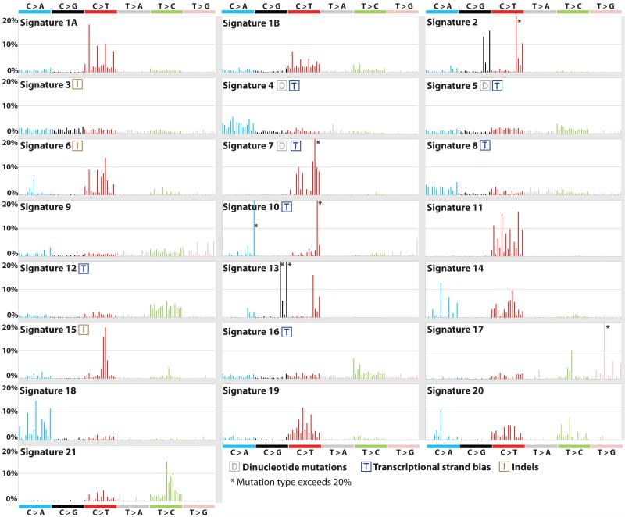
Deciphering the Mutational Processes
and DNA Repair Defects in Each Patient
Pattern of mutations
by sequencing
(without focus on
specific genes)
APOBEC
BRCA1/2
deficiency
MMR
deficiency
POLE
mutation
APOBEC
(+ NER, BER…..)
Synthetic lethality with DNA repair defect (PARPinh and BRCA defects)
Targeting mutational process?
Alexandrov LB, et al. Nature. 2013;500(7463):415-421.

Slide 32
Potential Applications of Genomics
to Identify Immune Defects in Individuals With mBC
Dendritic cell
Is the host capable of creating
adaptive immune response
following immunogenic cell death ?
What is the panel
of tumor antigens ?
Cancer cell
What is the
immunosuppressive
network induced
by cancer cells ?
Cytotoxic
T lymphocytes
Can the tumor present antigens ?
(TAP1, HLA-A mutations…)
What is the TcR
repertoire ?

Slide 33
Mutational Load and Efficacy of Anti-CTLA4 Ab
100 –
80 –
60 –
40 –
20 –
0 –
Mutational Load
Survival in Discovery Set
P = .009 by Mann-Whitney test
1750 –
1500 –
1250 –
1000 –
750 –
500 –
250 –
0 –
1750 –
1500 –
1250 –
1000 –
750 –
500 –
250 –
0 –
>100 mutations (N = 17)
P = .01 by Mann-Whitney test
Survival, % of Patients
No. of Exomic Missense Mutations
≤100 mutations (N = 8)
P = .04 by log-rank test
Long-term benefit
Minimal or no benefit
Long-term benefit
Minimal or no benefit
Discovery Set
Validation Set
0 20 40 60 80 100
Months
Snyder A, et al. N Engl J Med. 2014;371(23):2189-2199.

Slide 34
Clinical Utility of NGS

Slide 35
Information Needed for Adequate Sample Provision
DNA or RNA?
RNase-free environment
Quantity
cellularity
Quality and integrity
Pre-analytic variables
Platform to be used

Slide 36
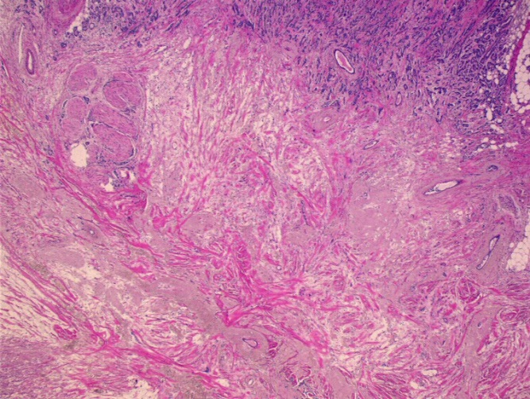
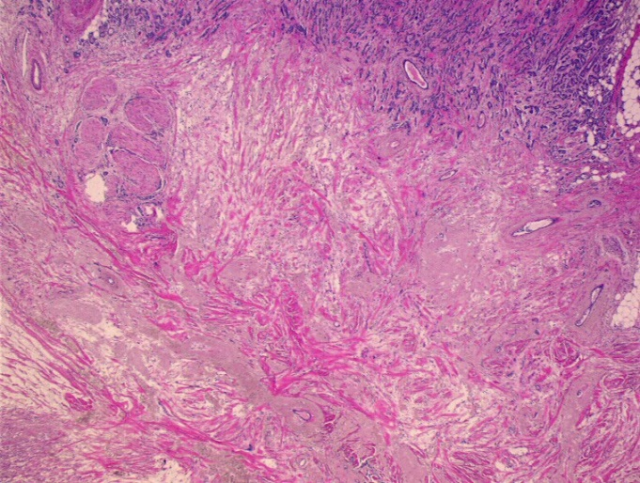
Sample Preparation
Choice of the most representative block
Invasive vs noninvasive vs precursors
Tumor cellularity (area vs % nuclei)
Whole sections vs cores
Age of the tissue sections
Macrodissection
Microdissection
Cytology smears

Slide 37
Potential Indications for Requesting NGS in Patients With Solid Tumors
Stage IV non-small cell lung cancer (NSCLC) – mainly adenocarcinomas
Carcinoma of unknown primary (CUP)
Rare solid tumors
Newly diagnosed patients with selected stage IV poor prognosis solid tumors

Slide 38
Whom to Molecularly Assess For Target Identification in Advanced Cancer
NSCLC adeno
EGFRm, ALKr, RETr, ROSr, HER2m, METa
Melanoma
BRAFm, (NRASm, KITm (a)?)
Colorectal
KRASm, NRASm, BRAFm
GIST
KITm, PDGFRαm
Glioblastoma:
MGMTmethyl
Breast:
HER2ae, ERe, PRe
Dermatofibrosarcoma:
PDGFRβr
Stomach:
HER2ae
m, mutated
r, rearranged
a, amplified
methyl, methylated
e, (over)expression
Notes:
Inflamatory myofibroblastic tumour

Slide 39
Whom to Molecularly Assess For Target Identification in Early Cancer
GIST
- Imatinib increases OS in adjuvant setting
Glioblastoma
- Temozolomide increases OS
Breast
- Trastuzumab, tamoxifen, and aromatase inhibitors in adjuvant setting improve OS
Colorectal
- Cetuximab failed in adjuvant setting
Lung
- EGFR TKI being tested
Melanoma
- BRAF and BRAF/MEK TKI in adjuvant setting being tested

Slide 40
Whom to Molecularly Assess For Target Identification in Early Cancer
GIST – Adjuvant Treatment
100 –
90 –
80 –
70 –
60 –
50 –
40 –
30 –
20 –
10 –
–
36 Months of Imatinib
Percentage
12 Months of Imatinib
HR, 0.46 (95% CI, 0.32-0.65)
Log-rank P<.001
0 1 2 3 4 5 6
Years Since Randomization
No. of patients
36 Months of imatinib 198 184 173 133 82 39 8
12 Months or imatinib 199 177 137 88 49 27 10
5-year survival rate 92% vs 81.7%
(HR 0.45 95% CI 0.22-0.89, P = .02)
Joensuu H, et al. JAMA. 2012;307(12):1265-1272.

Slide 41
Potential Indications: NSCLC

Slide 42
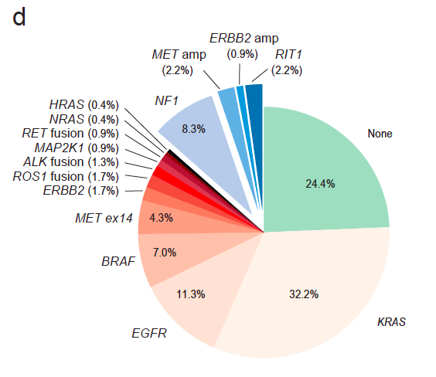
Frequency of Driver Alterations in Lung Adenocarcinoma
The Cancer Genome Atlas. Nature. 2014;511(7511):543-550.

Slide 43
Driver Alterations: What Should We Test For?
EGFR
ALK
HER-2
BRAF
RET
ROS
MET
Lindeman NI, et al. J Thorac Oncol. 2013;8(7):823-859.

Slide 44
Driver Alterations: What Should We Test For?
EGFR
ALK
HER-2
BRAF
RET
ROS
MET
Tissue should be prioritized for EGFR and ALK testing.
EGFR and ALK results should be available within 2 weeks (10 working days).
Lindeman NI, et al. J Thorac Oncol. 2013;8(7):823-859.

Slide 45
Survival of Patients With Drivers: Targeted Therapy vs No Targeted Therapy
Patients with an oncogenic driver mutation who did and did not receive targeted therapy, and patients without an oncogenic driver
1.0 –
08. –
0.6 –
0.4 –
0.2 –
0.0 –
No targeted therapy
Survival Probability
Targeted therapy
No driver
Log-rank P<.001
0 1 2 3 4 5
Years
Driver, no targeted therapy (A) | 313 | 2.4 years (1.8 to 2.9)
No driver (B) | 361 | 2.1 years (1.8 to 2.5)
Driver, targeted therapy (C) | 264 | 3.5 years (3.2 to 4.6)
Kris MG, et al. JAMA. 2014;311(19):1998-2006.

Slide 46
EGFR Mutations Are Located Predominantly on Exons 19 and 21
Exons
N-lobe
18
αC helix
G719X
3.2%
P-loop
P-loop
ATP binding cleft
Deletion
19
N
48.2%
αC helix
Activation loop
Insertion
20
C
K
3.7%
Kinase
domain
C-lobe
L858R
21
A-loop
Approximately 10-15% of all NSCLC
Patients have EGFR-mutated
disease
42.7%
Mitsudomi T, et al. Int J Clin Oncol. 2006;11(3):190-198. Rosell R, et al. N Engl J Med. 2009;361(10):958-967.
Riely GJ, et al. Clin Cancer Res. 2006;12(24):7232-7241.
Notes:
46

Slide 47
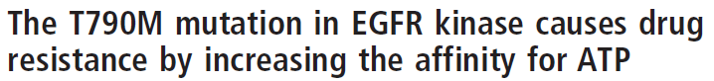
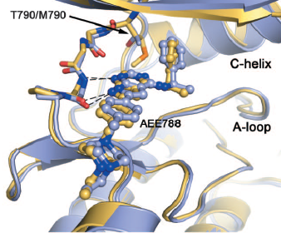
T790M Mechanism at Resistance
 | K_{d,}nM
Kinase | Gefitinib
WT | 35.3 ± 0.4
T790M | 4.6 ± 0.1
L858R | 2.4 ± 0.1
L858R/T790M | 10.9 ± 0.6
Enyme Kinetic Parameters of WT and Mutant EGFR
Kinase | K_{m[ATP], µM} | K_{cat, s}-1 | k_{cat}/K_{m[ATP], µM-1*S-1}
WT | 5.2 ± 0.2 | 0.026 | 5.00E-3
T790M | 5.9 ± 0.1 | 0.137 | 2.32E-2
L858R | 148 ± 4 | 1.484 | 1.00E-2
L858R/T790M | 8.4 ± 0.3 | 0.456 | 5.43E-2
Yun CH, et al. Proc Natl Acad Sci. 2008;105(6):2070-2075.
Notes:
In kinetic kinase experiments using mutant forms of EGFR, proteins with Leu858Arg or exon 19 deletions exhibit signifi cantly higher Michaelis
constants for ATP (Km[ATP]; substrate concentration at half the maximum reaction rate), and have increased affinity (5–10 times) to gefi tinib or erlotinib compared with the wild-type receptor. Whereas the acquisition of T790M restores its affinity for ATP to wild-type levels, reducing the effect of TKI.
The T790M mutation merely restores ATP affinity to the level of the WT kinase.
We cannot explain structurally
why the T790M mutation increases ATP affinity in the context
of the L858R mutant, but not in the context of the WT enzyme.
We also find that the T790M mutation activates the kinase
5-fold as compared with the WT enzyme (Table 2); this
catalytic activation of the T790M mutant likely explains its
presence as a germ-line mutation in a family predisposed to lung
cancer

Slide 48
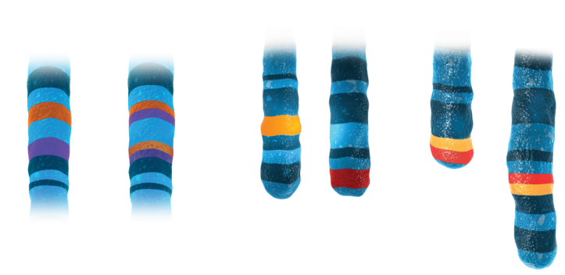
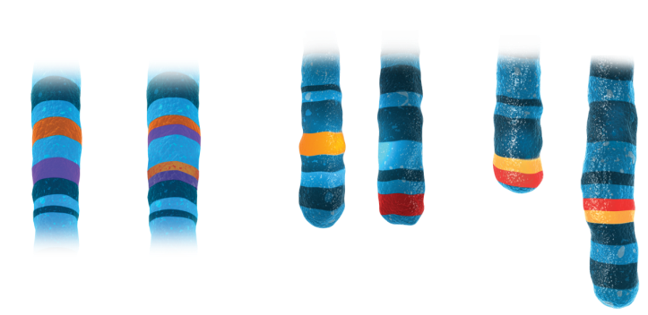

EML4-ALK Fusion Oncogene Key Driver in 2% to 7% NSCLC
ALK rearrangements induce ALK protein expression.
Constitutive ALK activation → oncogene addiction
Inversion
Translocation
or
ALK, anaplastic lymphoma kinase; EML4, echinoderm microtubule-associated protein like 4
Soda M, et al. Nature. 2007;448(7153):561-566. Kwak EL, et al. N Engl J Med. 2010;363(18):1693-1703.

Slide 49
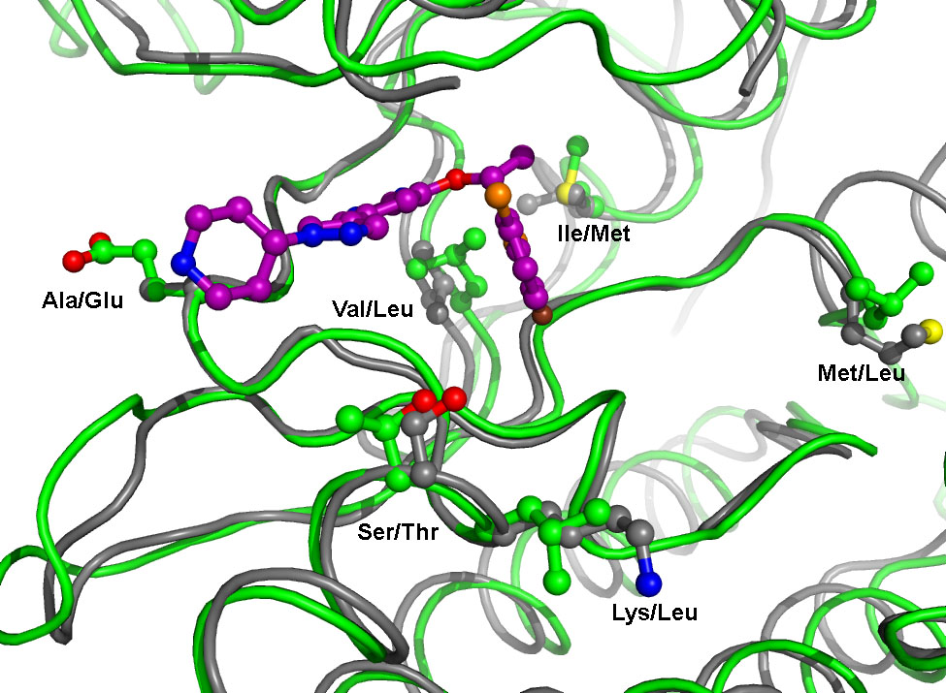
ROS1 and ALK TK Domains Are Similar 77% Identity in ATP-Binding Site
G-Loop
GK
Extended Hinge Region
C-Terminus
N-Terminus
Kinase | L1 | L9 | N1 | N2 | N3 | N4 | N5 | H1 | H3 | H4 | H5 | H6 | H7 | H8 | H9 | H10 | H11 | H12 | H13 | C1 | C2 | C3 | C4 | C5 | C6 | C7 | C8
ALK | L | V | A | K | E | I | V | I | L | E | L | M | A | G | G | D | L | K | S | R | N | L | G | D | F | G | M
ROS1 | L | V | A | K | E | M | L | I | L | E | L | M | E | G | G | D | L | L | T | R | N | L | G | D | F | G | L
ROS1

Slide 50
ROS1 and ALK TK Domains Are Similar 77% Identity in ATP-Binding Site
GK
Best Tumor Response in ROS1-Rearranged Lung Cancer
100 –
80 –
60 –
40 –
20 –
0 –
-20 –
-40 –
-60 –
-80 –
-100 –
N-Terminus
Extended Hinge Region
C-Terminus
Kinase | L1 | L9 | N1 | N2 | N3 | N4 | N5 | H1 | H3 | H4 | H5 | H6 | H7 | H8 | H9 | H10 | H11 | H12 | H13 | C1 | C2 | C3 | C4 | C5 | C6 | C7 | C8
ALK | L | V | A | K | E | I | V | I | L | E | L | M | A | G | G | D | L | K | S | R | N | L | G | D | F | G | M
ROS1 | L | V | A | K | E | M | L | I | L | E | L | M | E | G | G | D | L | L | T | R | N | L | G | D | F | G | L
CR
Best Response From Baseline, %
ROS1
1 2 3 4 5 6 7 8 9 10 11 12 13 14 15 16 17 18 19 20 21 22 23 24 25 26
SD
77% RR to crizotinib
PR

Slide 51
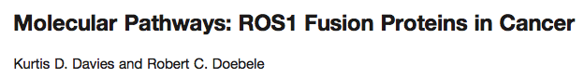
A More Complex Picture Missing Driver Proof of Concept
1%-2% NSCLC, responsive to ROS TKIs
8.7% (2/23) in cholangiocarcinomas
0.5% (1/200) in ovarian cancers
0.6% (3/495) in gastric adenocarcinomas
0.8% (2/ 236) in colorectal cancers
7.7% (2/26) in inflammatory myofibroblastic tumors
2.9% (1/34) in angiosarcomas
5% (1/20) in epithelioid hemangioendotheliomas
Will all these tumor sites respond to ROS-targeted therapy?
Davies KD, et al. Clin Cancer Res. 2013;19(15):4040-4045.

Slide 52
Potential Indications: Cancer of Unknown Primary, Rare Tumors, and Patients Who Have Exhausted Standard Treatments

Slide 53
Cancer of Unknown Primary (CUP)
More molecular information may help identify the potential site of origination and any mutations that may potentially be targeted with therapy
Rare tumors with aggressive biology
May not have time for trial and error with different treatments; NGS may identify targetable mutations
Patients who have exhausted standard treatments
NGS may identify new targetable mutations

Slide 54
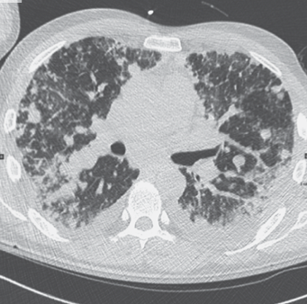
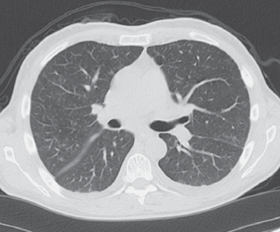
A Specific Driver Mutation in Anaplastic Thyroid Cancer
Rosove MH, et al. N Engl J Med. 2013;368(7):684-685.

Slide 55
Potential Indications: Breast Cancer

Slide 56
Candidate Actionable Genomic Alterations in Breast Cancer (With Drugs Under Development)
35
10-20 candidate actionable drivers
Most occurring in <10% of patients
Mutations and copy-number alterations
30
25
20
% of Primary Tumors
15
TNBC
10
TNBC
TNBC
5
0
FGFR1 ampli
INPP4B LOH
EGFR ampli
ERBB2 ampli
CDKN2A loss
FGFR2 ampli
CCND1 ampli
Rb1 mutations
AKT1 mutations
KRAS mutations
STK11 mutations
PIK3CA mutations
MDM2 amplifications
PTPRD mutations
PTPN22 mutations
ERBB2 mutations
PTEN loss or mutations
Stephens PJ, et al. Nature. 2012;486(7403):400-404. The Cancer Genome Atlas Network. Nature. 2012;490(7418):61-70. Gewinner C, et al. Cancer Cell. 2009;16(2):115-125. André F, et al. Clin Cancer Res. 2009;15(2):417-419. Turner N, et al. Oncogene. 2010;29(14):20136-2023.

Slide 57
Challenges in Stratified Medicine for mBC
35
30
25
20
% of Primary Tumors
AKT1 mutations: 4% of BC
Minimal number of patients needed for a randomized trial: 200
Number of patients to be screened for the mutation: 5000!!!!!
15
10
5
0
FGFR1 ampli
INPP4B LOH
EGFR ampli
ERBB2 ampli
CDKN2A loss
FGFR2 ampli
CCND1 ampli
Rb1 mutations
AKT1 mutations
KRAS mutations
STK11 mutations
PIK3CA mutations
PTPRD mutations
PTPN22 mutations
ERBB2 mutations
MDM2 amplifications
BRCA1/2 mutations
PTEN loss or mutations
Accrual is the challenge of stratified medicine in mBC:
How to screen genomic alterations in 5000-10,000 metastatic breast cancer patients?
Stephens PJ, et al. Nature. 2012;486(7403):400-404. The Cancer Genome Atlas Network. Nature. 2012;490(7418):61-70. Gewinner C, et al. Cancer Cell. 2009;16(2):115-125. André F, et al. Clin Cancer Res. 2009;15(2):417-419. Turner N, et al. Oncogene. 2010;29(14):20136-2023.

Slide 58
Possible Solution: Use of Circulating DNA to Screen Genomic Alterations in Centers That Do Not Routinely Perform Biopsies
Network of referral
centers
Hub center:
Blood analysis
Inclusion
patient
Blood

Slide 59
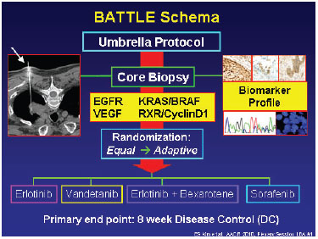
Example of a Basket Study: The Battle Trial
Umbrella Protocol
Core Biopsy
Biomarker Profile
EGFR KRAS/BRAF
VEGF RXR/CyclinD1
Randomization:
Equal Adaptive
Erlotinib
Vandetanib
Erlotinib + Bexarotene
Sorafenib
Primary endpoint: 8-week disease control (DC)

Slide 60
Conclusions and prIME PointsTM

Slide 61
prIME PointsTM
Molecular targeted treatments are providing new therapeutic options across multiple malignancies
Predictive biomarkers needed to utilize targeted treatments
NGS provides detailed information on actionable mutations
Technical developments improving accuracy and reducing costs
Interpretation requires specialist knowledge

Slide 62
prIME PointsTM
Provides information on tumor biology and patient selection for clinical trials
May soon replace multiple individual biomarker testing in some cancers, eg, lung adenocarcinoma
Of potential clinical value in rare solid tumors and for patients of good performance status with advanced disease who have exhausted standard treatments

